Slide 1
MIPS programming
Teaching assistant : 黃怡庭、黃梓豪、周哲宇
2023/3/2
Due Date: 3/22 23:59

Slide 2
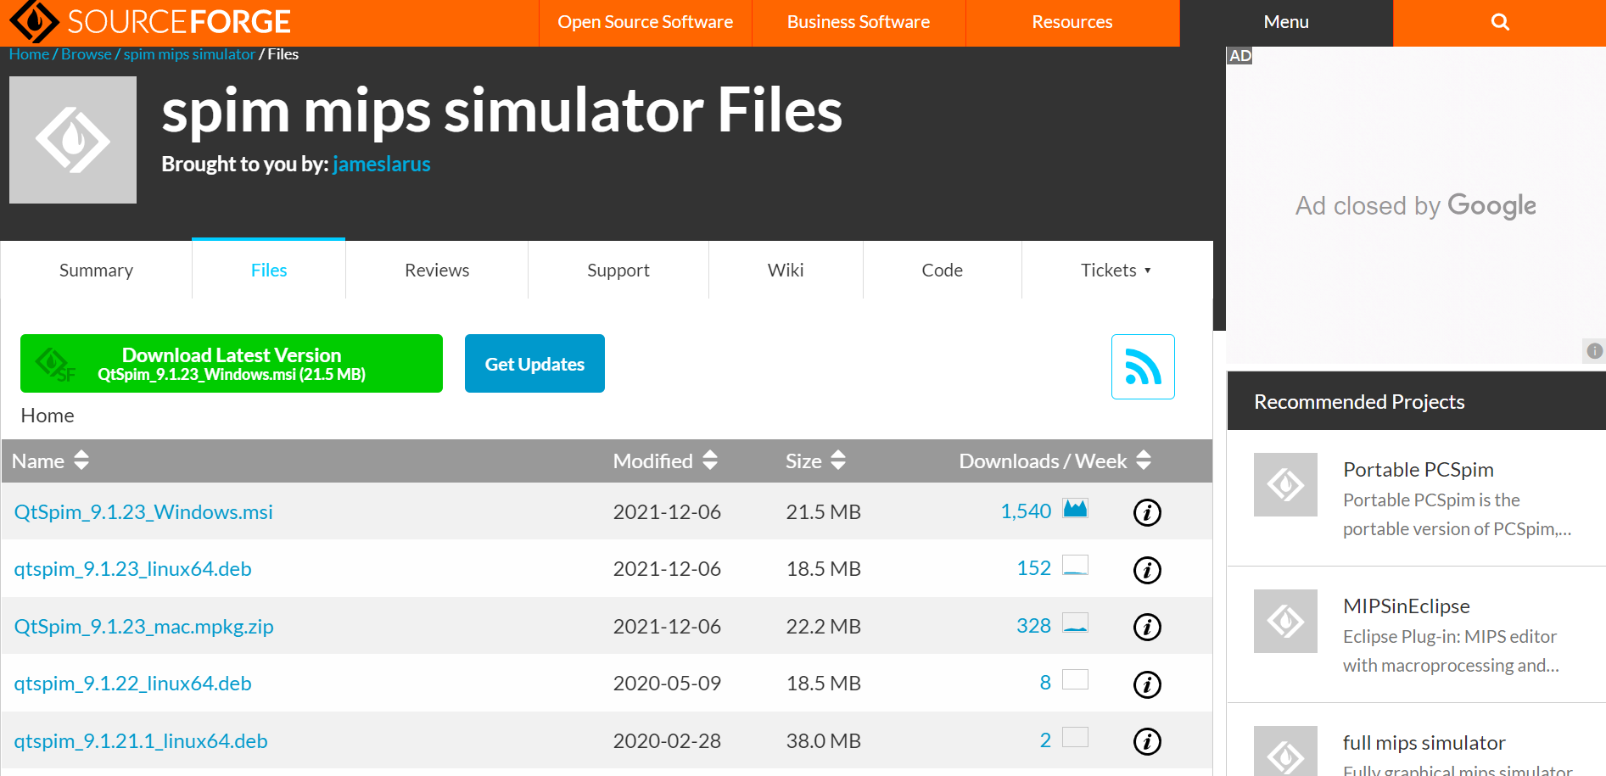
Download QtSpim
https://sourceforge.net/projects/spimsimulator/files/
1. Click here to download
2. Install it

Slide 3
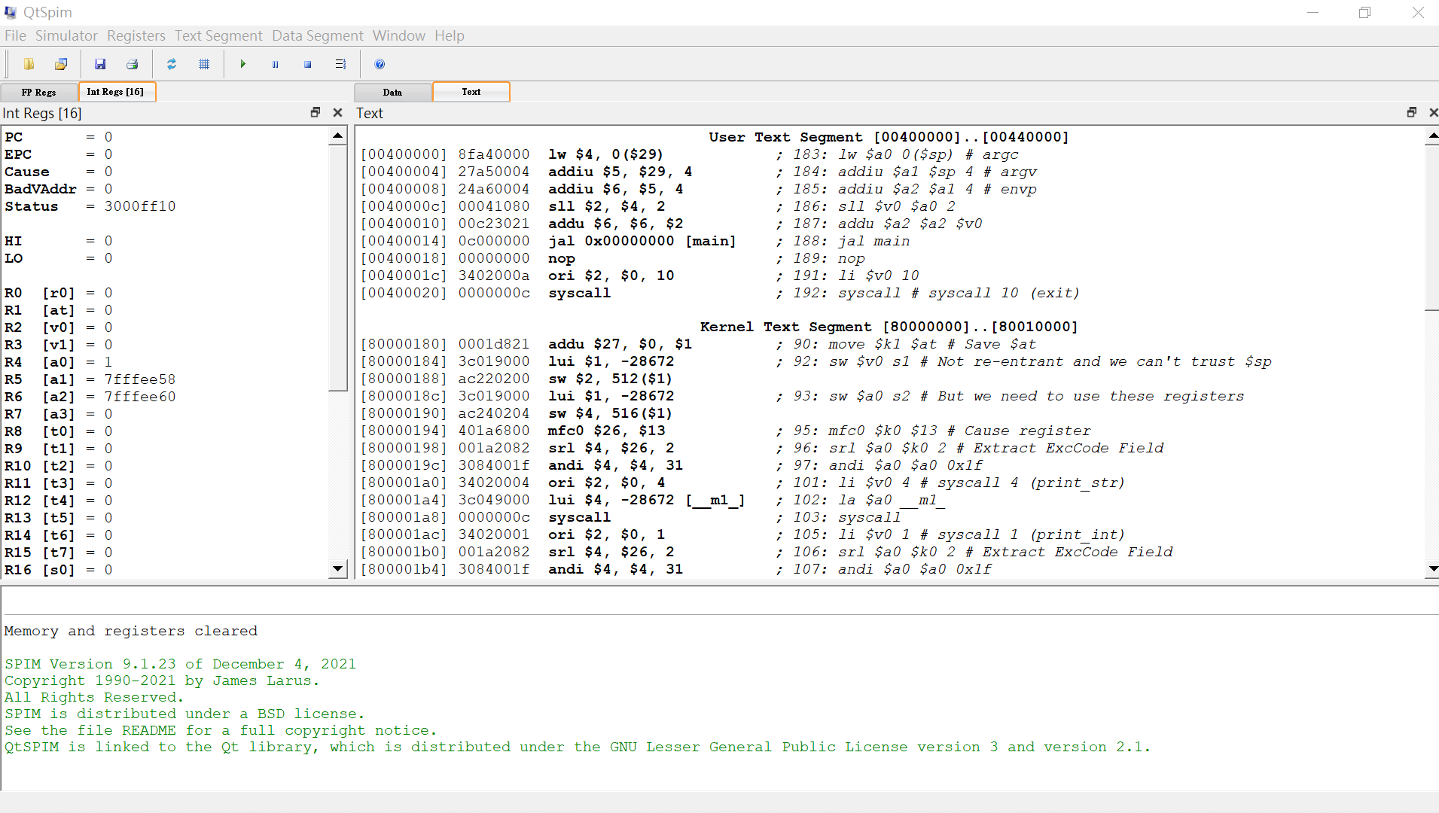
How to use
1. Click here to open your assembly code file

Slide 4
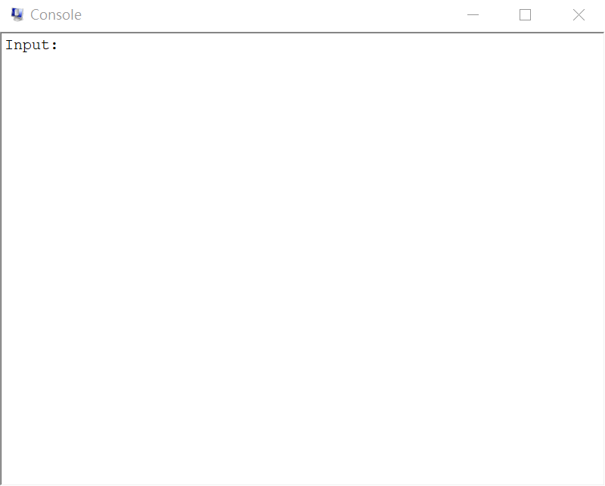
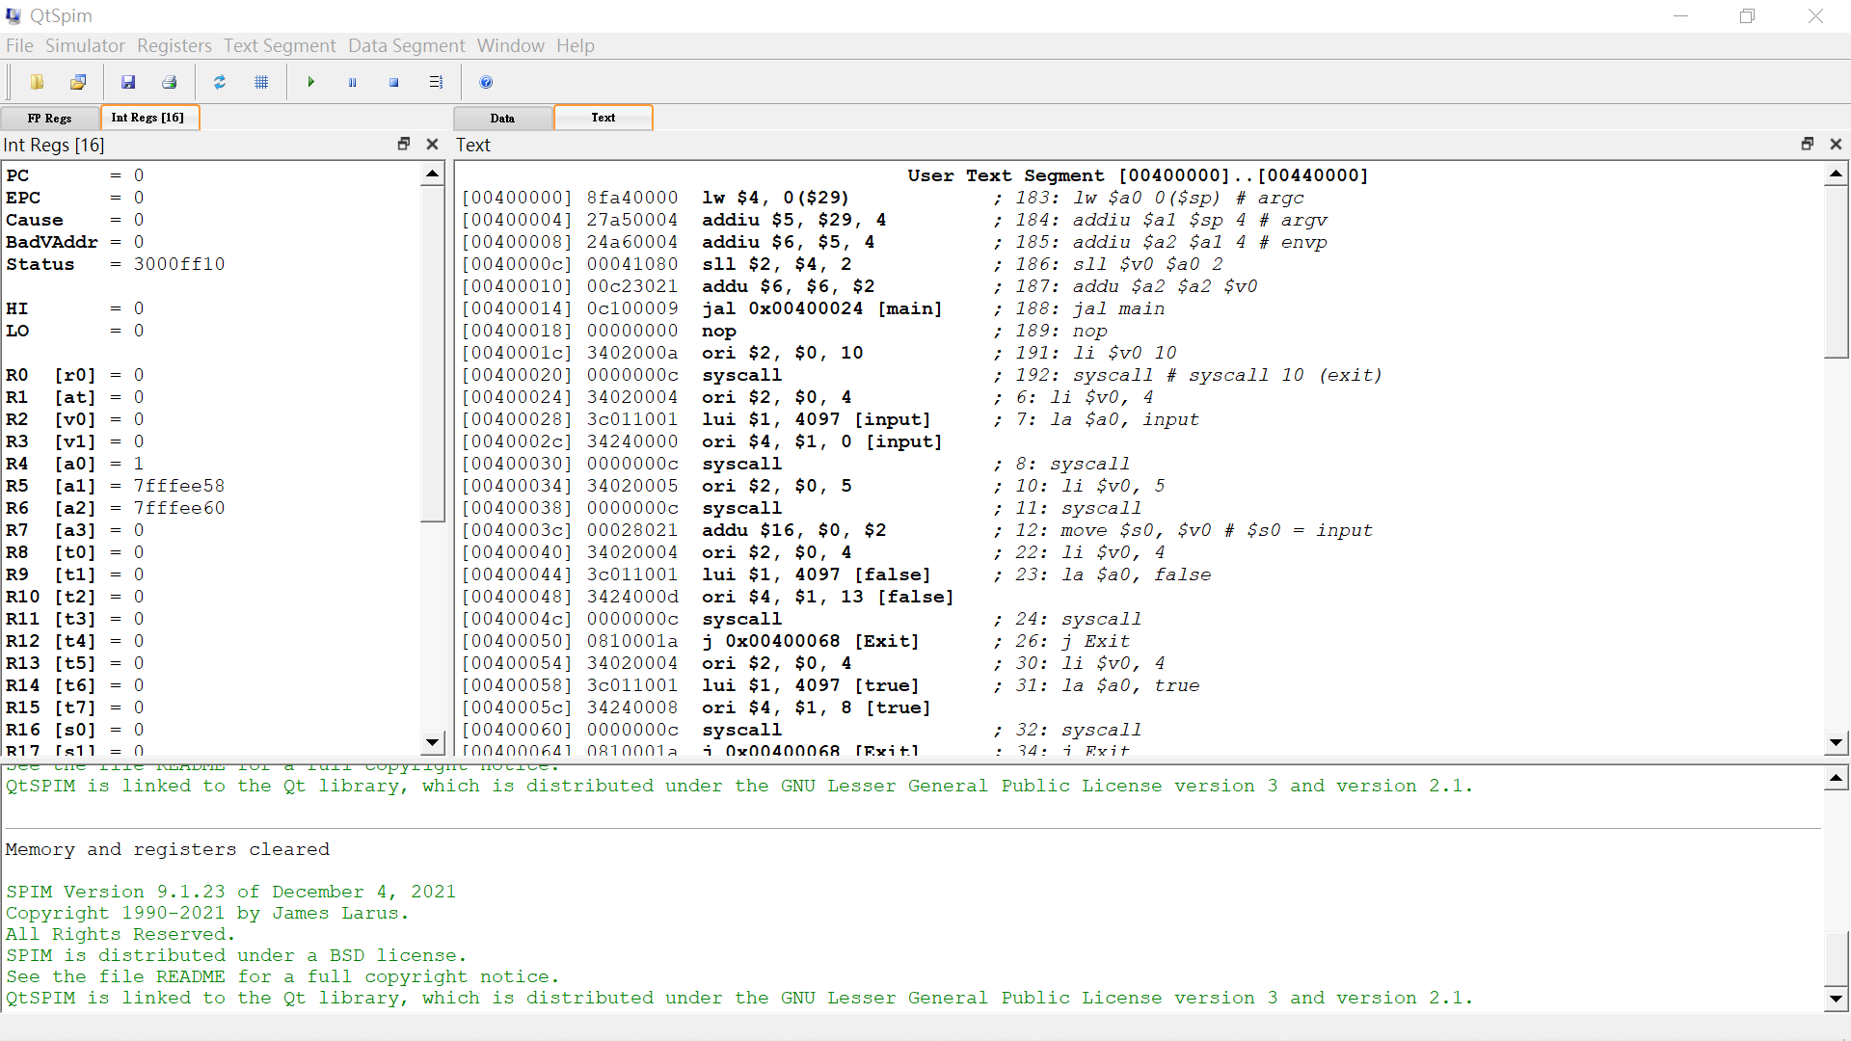
How to use
2. Run your code and Console window will show the outputs

Slide 5
How to use
Register
Data
Text
Message

Slide 6
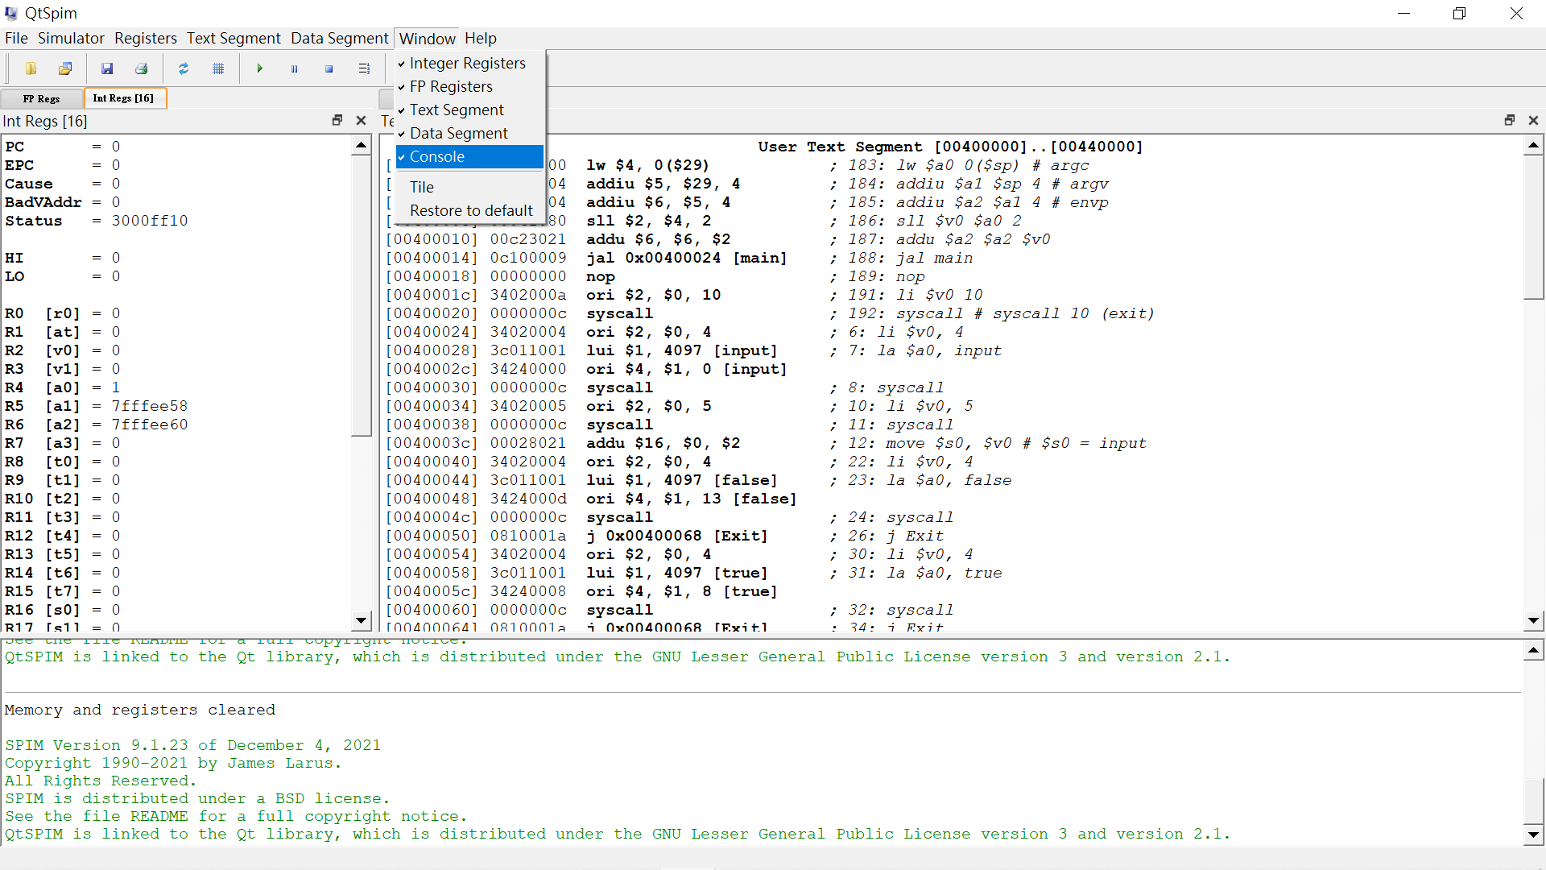
If you can not find the Console window

Slide 7
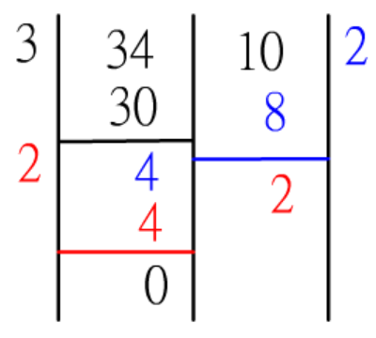
Project : Euclidean algorithm
Using Euclidean algorithm to find the greatest common factor.
Using MIPS to complete this project.
Please do it yourself and do not copy others work.

Slide 8
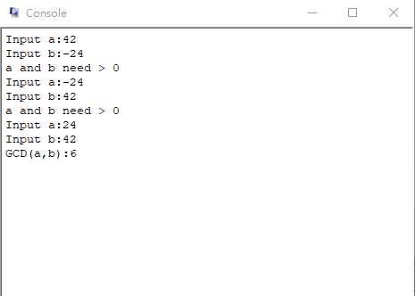
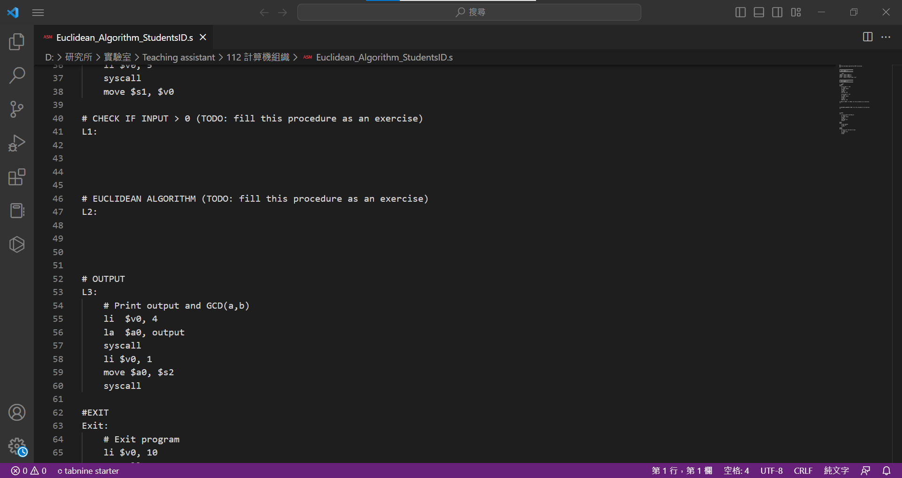
Project : Euclidean algorithm
your code
your code

